Slide 1
Week 4 Tutorial
Forecasting and valuing cash flows
Zirui Song
^{March 2025}

Slide 2
Agenda
2-3
2-6
2-7 (Exercises done in Week 2)
2-8
2-10*
2-12

Slide 3
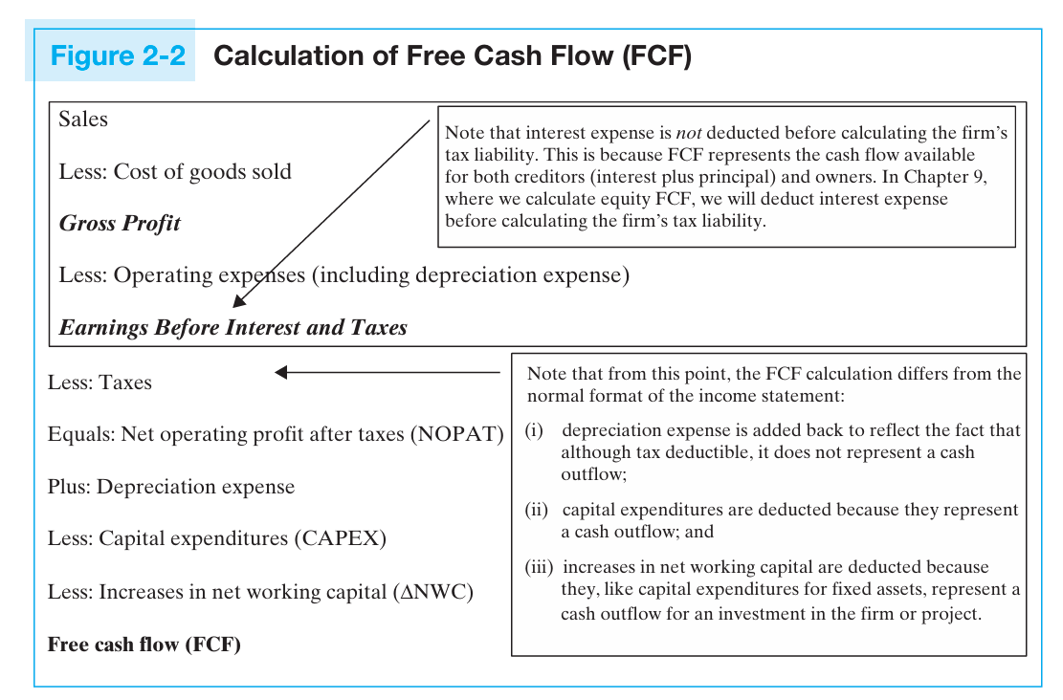
Knowledge review 1: FCF, CAPEX
Firm FCF (FFCF) vs. Equity FCF (EFCF)
aka net operating income

Slide 4
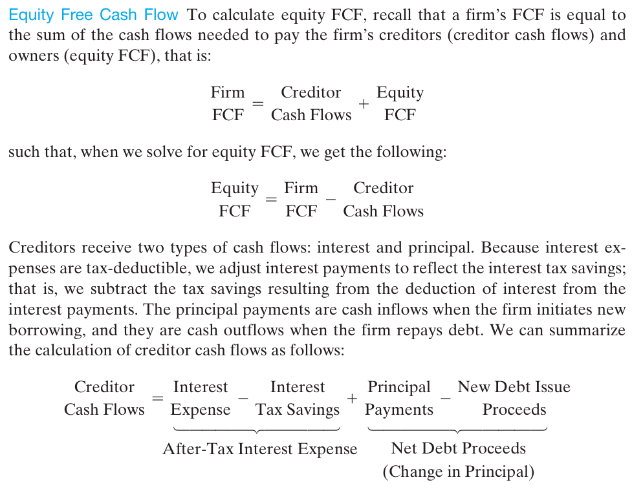
Knowledge review 1: FCF, CAPEX
Source: textbook, page 105

Slide 5
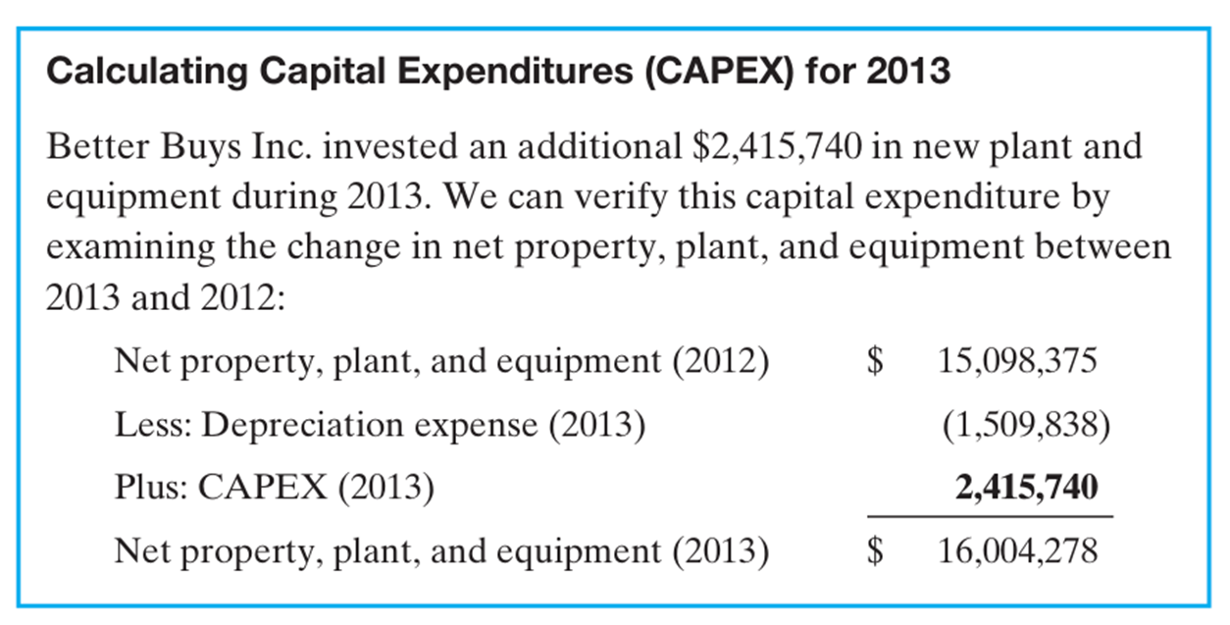

Knowledge review 1: FCF, CAPEX
$${PPE}_{ending}={PPE}_{beginning}+CAPEX−Depreciation Expense$$
$$CAPEX={PPE}_{ending}−{PPE}_{beginning}+Depreciation Expense$$

Slide 6
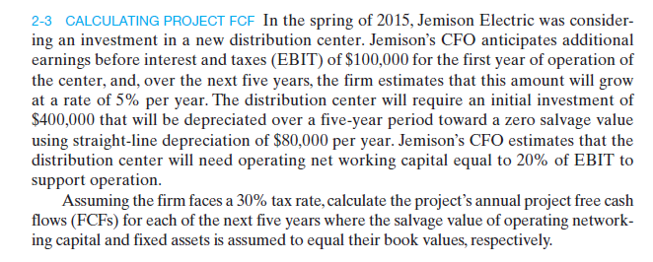
Question 1

Slide 7
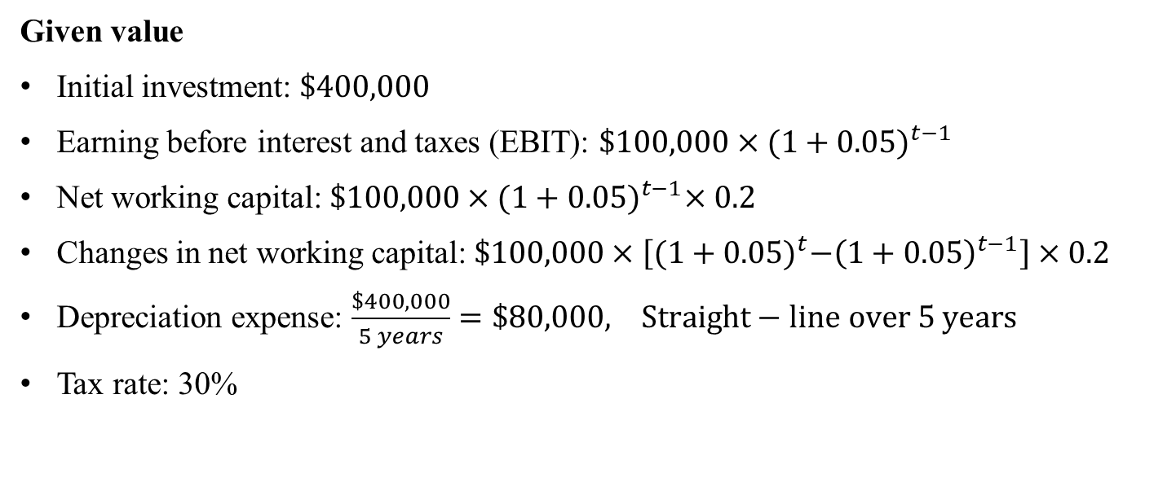
Question 1 (cont.)
Given value
Initial investment: $\$400,000$
Earning before interest and taxes (EBIT): $\$100,000×{(1+0.05)}^{t−1}$
Net working capital: $\$100,000×{(1+0.05)}^{t−1}×0.2$
Changes in net working capital: $\$100,000×\left[{(1+0.05)}^{t}−{\left(1+0.05\right)}^{t−1}\right]×0.2$
Depreciation expense: $\frac{\$400,000}{5 years}=\$80,000, Straight−line over 5 years$
Tax rate: 30%

Slide 8
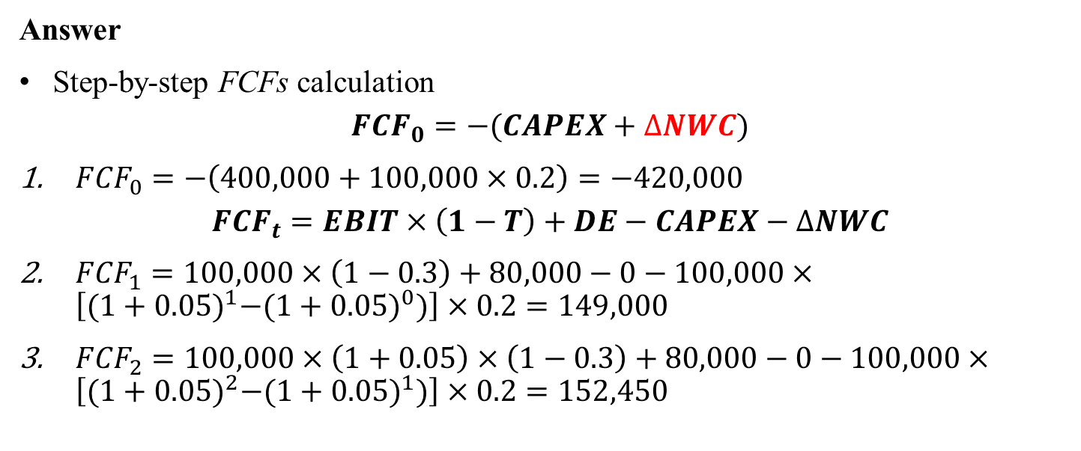
Question 1 (cont.)
Answer
Step-by-step FCFs calculation
$${FCF}_{0}=−(CAPEX+∆NWC)$$
${FCF}_{0}=−\left(400,000+100,000×0.2\right)=−420,000$
$${FCF}_{t}=EBIT×\left(1−T\right)+DE−CAPEX−∆NWC$$
${FCF}_{1}=100,000×\left(1−0.3\right)+80,000−0−100,000×\left[{(1+0.05)}^{1}−{(1+0.05)}^{0})\right]×0.2=149,000$
${FCF}_{2}=100,000×\left(1+0.05\right)×\left(1−0.3\right)+80,000−0−100,000×\left[{(1+0.05)}^{2}−{(1+0.05)}^{1})\right]×0.2=152,450$

Slide 9
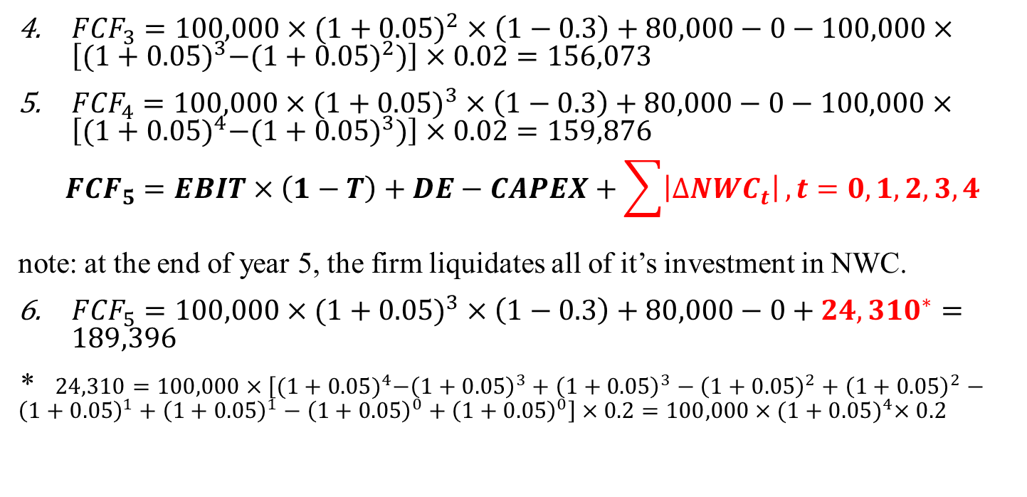
Question 1 (cont.)
${FCF}_{3}=100,000×(1+0.05)^{2}×\left(1−0.3\right)+80,000−0−100,000×\left[{(1+0.05)}^{3}−{(1+0.05)}^{2})\right]×0.02=156,073$
${FCF}_{4}=100,000×(1+0.05)^{3}×\left(1−0.3\right)+80,000−0−100,000×\left[{(1+0.05)}^{4}−{(1+0.05)}^{3})\right]×0.02=159,876$
$${FCF}_{5}=EBIT×\left(1−T\right)+DE−CAPEX+\sum{\left|∆{NWC}_{t}\right|}, t=0,1,2,3,4$$
note: at the end of year 5, the firm liquidates all of it’s investment in NWC.
${FCF}_{5}=100,000×(1+0.05)^{3}×\left(1−0.3\right)+80,000−0+{24,310}^{∗}=189,396$
* $24,310=100,000×\left[{(1+0.05)}^{4}−{\left(1+0.05\right)}^{3}+{\left(1+0.05\right)}^{3}−{\left(1+0.05\right)}^{2}+{\left(1+0.05\right)}^{2}−{\left(1+0.05\right)}^{1}+{\left(1+0.05\right)}^{1}−{\left(1+0.05\right)}^{0}+{\left(1+0.05\right)}^{0}\right]×0.2=100,000×{(1+0.05)}^{4}×0.2$

Slide 10
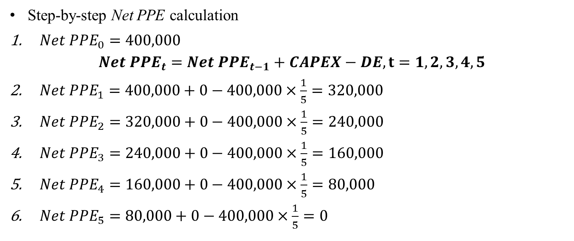
Question 1 (cont.)
Step-by-step Net PPE calculation
$Net {PPE}_{0}=400,000$
$$Net {PPE}_{t}=Net {PPE}_{t−1}+CAPEX−DE, t=1,2,3,4,5$$
$Net {PPE}_{1}=400,000+0−400,000×\frac{1}{5}=320,000$
$Net {PPE}_{2}=320,000+0−400,000×\frac{1}{5}=240,000$
$Net {PPE}_{3}=240,000+0−400,000×\frac{1}{5}=160,000$
$Net {PPE}_{4}=160,000+0−400,000×\frac{1}{5}=80,000$
$Net {PPE}_{5}=80,000+0−400,000×\frac{1}{5}=0$

Slide 11
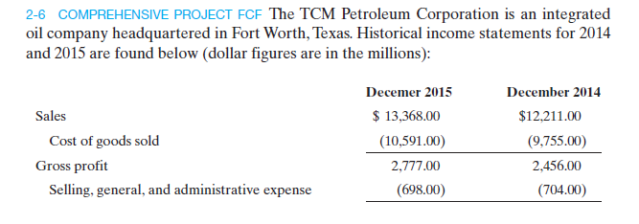
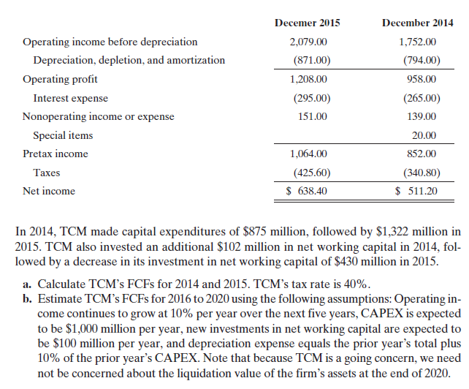
Question 2

Slide 12
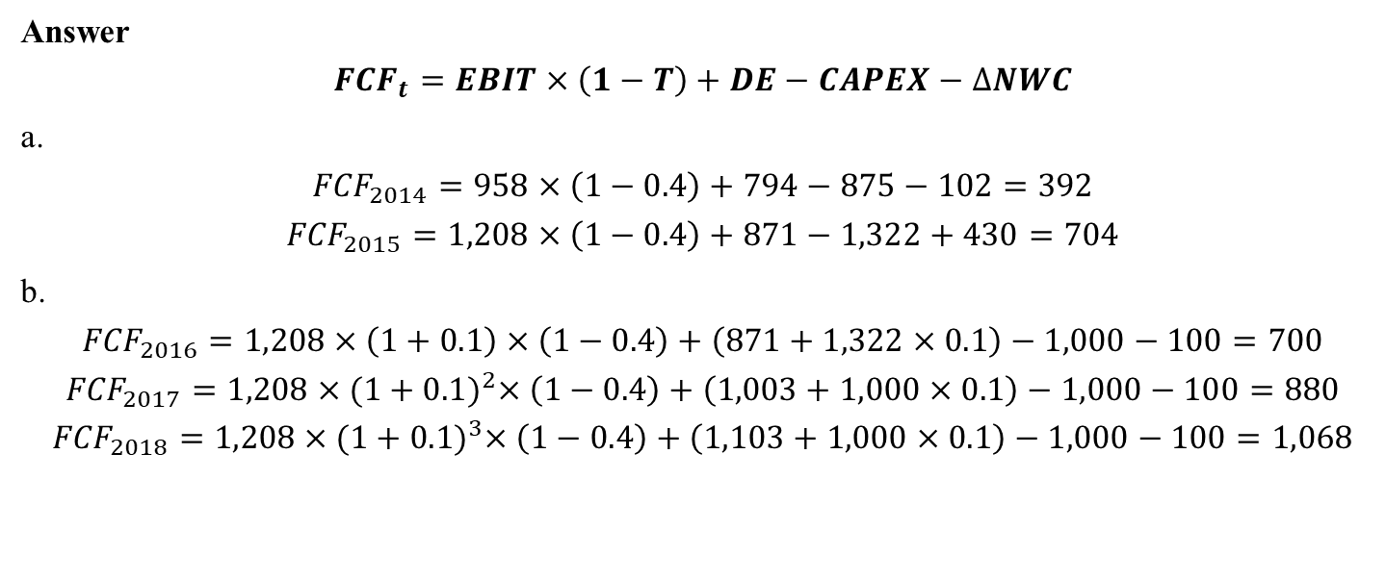
Question 2 (cont.)
Answer
$${FCF}_{t}=EBIT×\left(1−T\right)+DE−CAPEX−∆NWC$$
a.
$${FCF}_{2014}=958×\left(1−0.4\right)+794−875−102=392$$
$${FCF}_{2015}=1,208×\left(1−0.4\right)+871−1,322+430=704$$
b.
$${FCF}_{2016}=1,208×\left(1+0.1\right)×\left(1−0.4\right)+\left(871+1,322×0.1\right)−1,000−100=700$$
$${FCF}_{2017}=1,208×{(1+0.1)}^{2}×\left(1−0.4\right)+\left(1,003+1,000×0.1\right)−1,000−100=880$$
$${FCF}_{2018}=1,208×{(1+0.1)}^{3}×\left(1−0.4\right)+\left(1,103+1,000×0.1\right)−1,000−100=1,068$$

Slide 13

Question 2 (cont.)
$${FCF}_{2019}=1,208×{(1+0.1)}^{4}×\left(1−0.4\right)+\left(1,203+1,000×0.1\right)−1,000−100=1,264$$
$${FCF}_{2020}=1,208×{(1+0.1)}^{5}×\left(1−0.4\right)+\left(1,403+1,000×0.1\right)−1,000−100=1,470$$

Slide 14
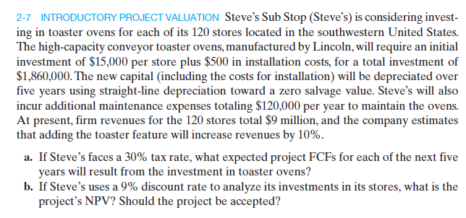
Same as Week 2, Question 4 (Pages 20-22). See slides.

Slide 15
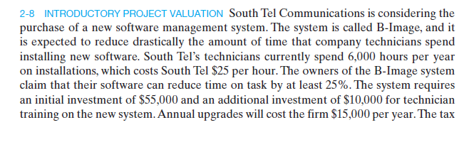
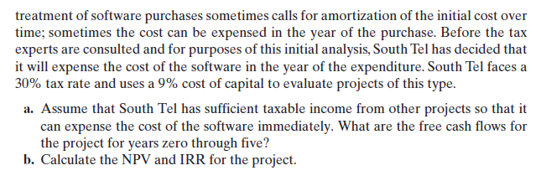
Question 3
Expense rather than capitalization: no depreciation

Slide 16
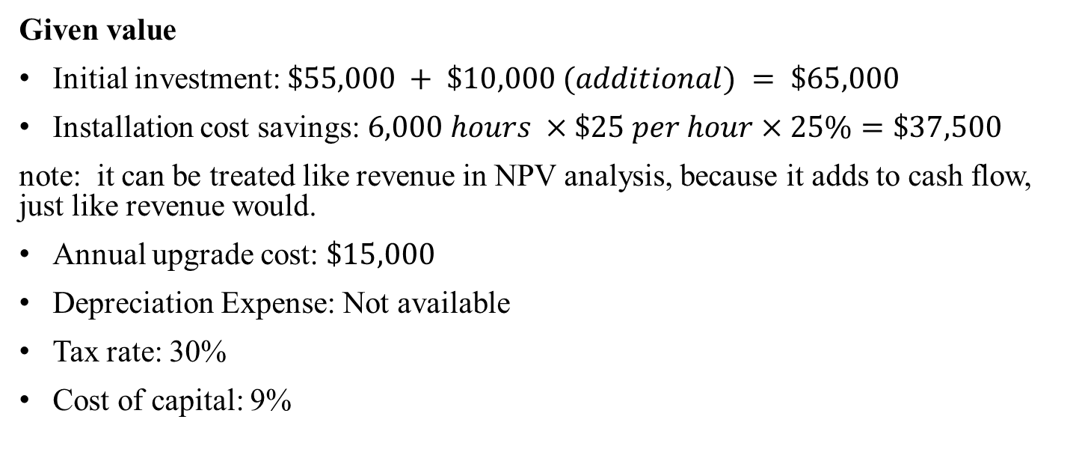
Question 3 (cont.)
Given value
Initial investment: $\$55,000 + \$10,000 (additional) = \$65,000$
Installation cost savings: $6,000 hours ×\$25 per hour×25\%=\$37,500$
note: it can be treated like revenue in NPV analysis, because it adds to cash flow, just like revenue would.
Annual upgrade cost: $\$15,000$
Depreciation Expense: Not available
Tax rate: 30%
Cost of capital: 9%

Slide 17
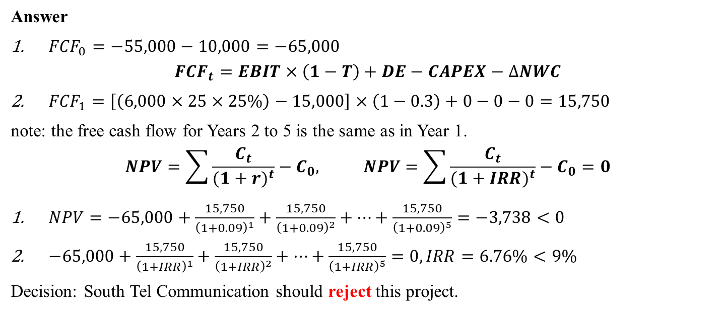
Question 3 (cont.)
Answer
${FCF}_{0}=−55,000−10,000=−65,000$
$${FCF}_{t}=EBIT×\left(1−T\right)+DE−CAPEX−∆NWC$$
${FCF}_{1}=\left[\left(6,000×25×25\%\right)−15,000\right]×\left(1−0.3\right)+0−0−0=15,750$
note: the free cash flow for Years 2 to 5 is the same as in Year 1.
$$NPV=\sum{\frac{C_{t}}{{(1+r)}^{t}}−C_{0}, NPV=\sum{\frac{C_{t}}{{(1+IRR)}^{t}}−C_{0}=0}}$$
$NPV=−65,000+\frac{15,750}{{\left(1+0.09\right)}^{1}}+\frac{15,750}{{\left(1+0.09\right)}^{2}}+…+\frac{15,750}{{\left(1+0.09\right)}^{5}}=−3,738<0$
$−65,000+\frac{15,750}{{\left(1+IRR\right)}^{1}}+\frac{15,750}{{\left(1+IRR\right)}^{2}}+…+\frac{15,750}{{\left(1+IRR\right)}^{5}}=0, IRR=6.76\%<9\%$
Decision: South Tel Communication should reject this project.

Slide 18
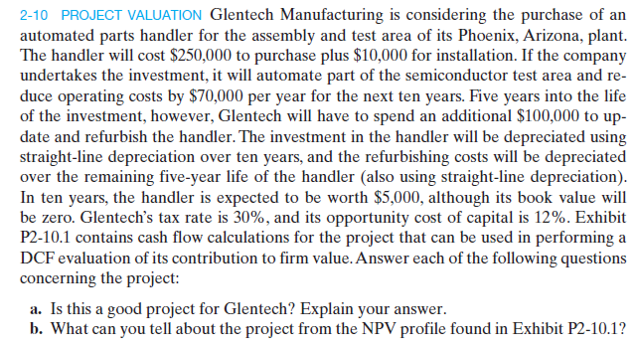
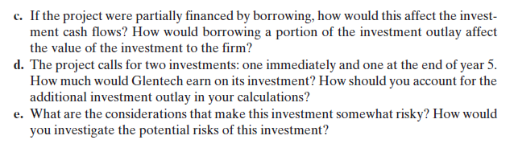
Question 4

Slide 19
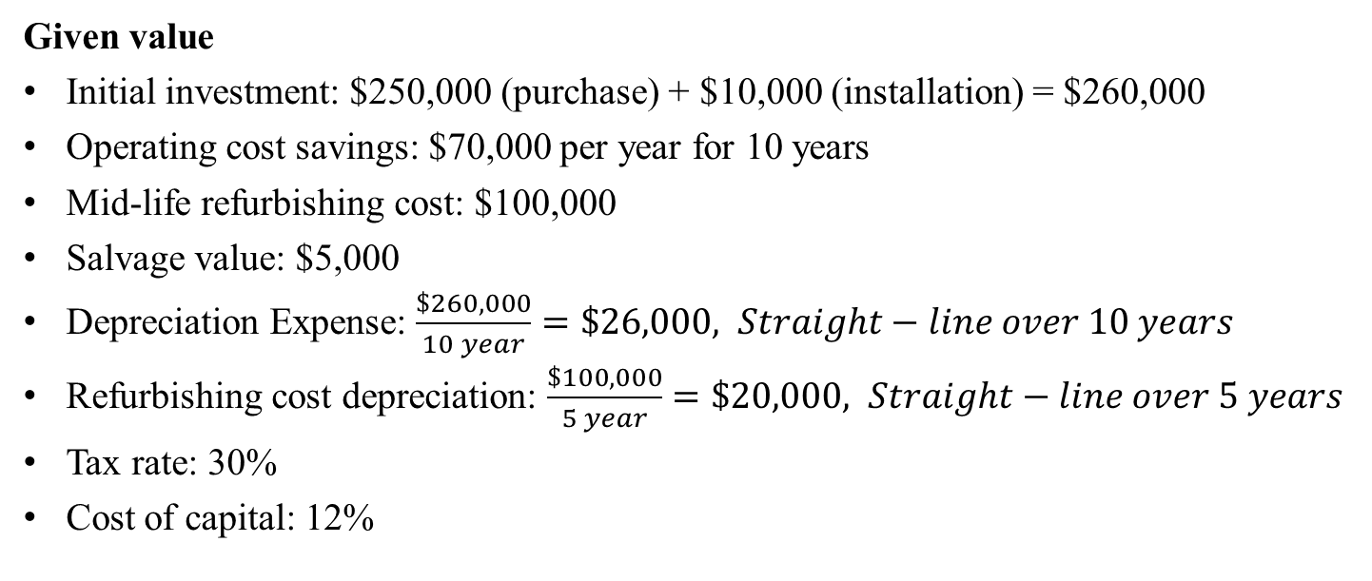
Question 4 (cont.)
Given value
Initial investment: $250,000 (purchase) + $10,000 (installation) = $260,000
Operating cost savings: $70,000 per year for 10 years
Mid-life refurbishing cost: $100,000
Salvage value: $5,000
Depreciation Expense: $\frac{\$260,000}{10 year}=\$26,000, Straight−line over 10 years$
Refurbishing cost depreciation: $\frac{\$100,000}{5 year}=\$20,000, Straight−line over 5 years$
Tax rate: 30%
Cost of capital: 12%

Slide 20
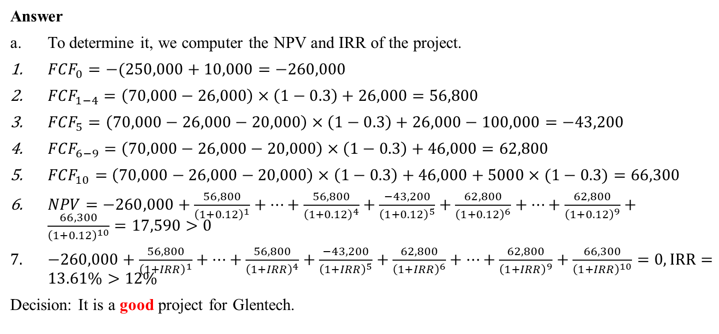
Question 4 (cont.)
Answer
To determine it, we computer the NPV and IRR of the project.
${FCF}_{0}=−(250,000+10,000=−260,000$
${FCF}_{1−4}=\left(70,000−26,000\right)×\left(1−0.3\right)+26,000=56,800$
${FCF}_{5}=\left(70,000−26,000−20,000\right)×\left(1−0.3\right)+26,000−100,000=−43,200$
${FCF}_{6−9}=\left(70,000−26,000−20,000\right)×\left(1−0.3\right)+46,000=62,800$
${FCF}_{10}=$ $\left(70,000−26,000−20,000\right)×\left(1−0.3\right)+46,000+5000×(1−0.3)=66,300$
$NPV=−260,000+\frac{56,800}{{\left(1+0.12\right)}^{1}}+…+\frac{56,800}{{\left(1+0.12\right)}^{4}}+\frac{−43,200}{{\left(1+0.12\right)}^{5}}+\frac{62,800}{{\left(1+0.12\right)}^{6}}+…+\frac{62,800}{{\left(1+0.12\right)}^{9}}+\frac{66,300}{{\left(1+0.12\right)}^{10}}=17,590>0$
$−260,000+\frac{56,800}{{\left(1+IRR\right)}^{1}}+…+\frac{56,800}{{\left(1+IRR\right)}^{4}}+\frac{−43,200}{{\left(1+IRR\right)}^{5}}+\frac{62,800}{{\left(1+IRR\right)}^{6}}+…+\frac{62,800}{{\left(1+IRR\right)}^{9}}+\frac{66,300}{{\left(1+IRR\right)}^{10}}=0, IRR=13.61\%>12\%$
Decision: It is a good project for Glentech.

Slide 21
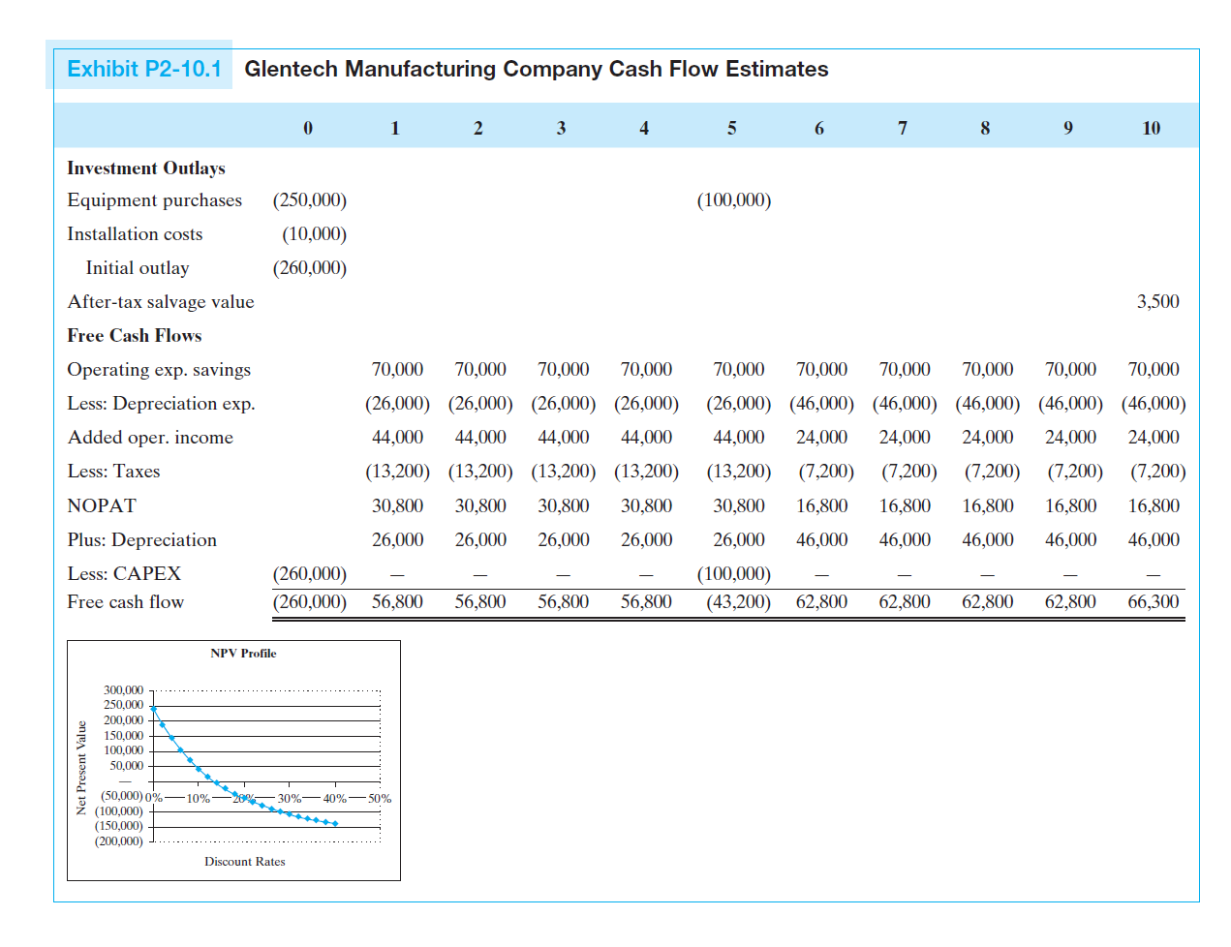
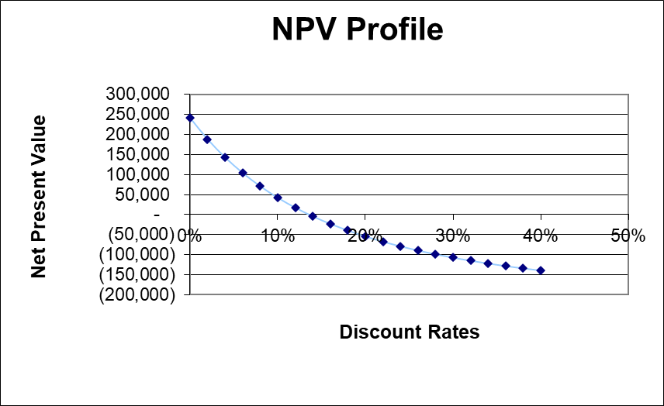
Question 4 (cont.)
The answers are as follows:
Reverse relationship between NPV and discount rate;
The project’s positive NPV of $17,590 at 12% discount rate indicates it creates value;
But its IRR of 13.61% suggests a narrow margin, making it sensitive to changes in the cost of capital.
Break-even point (IRR, 13.61%)
Cost of capital (12%)

Slide 22
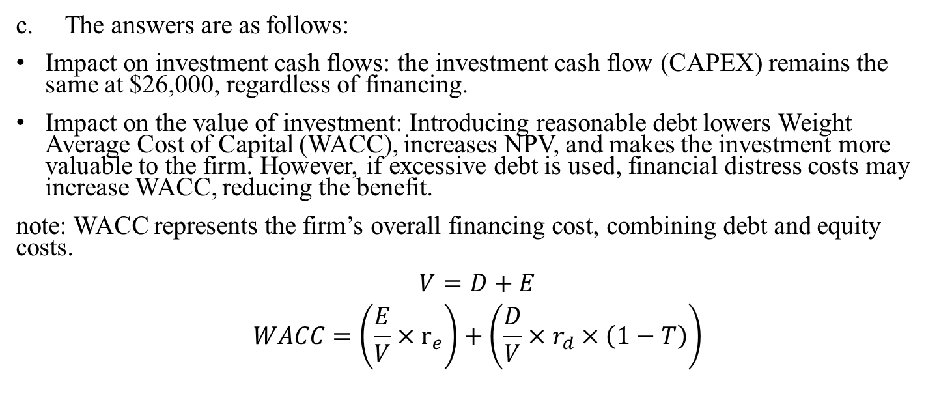
Question 4 (cont.)
The answers are as follows:
Impact on investment cash flows: the investment cash flow (CAPEX) remains the same at $26,000, regardless of financing.
Impact on the value of investment: Introducing reasonable debt lowers Weight Average Cost of Capital (WACC), increases NPV, and makes the investment more valuable to the firm. However, if excessive debt is used, financial distress costs may increase WACC, reducing the benefit.
note: WACC represents the firm’s overall financing cost, combining debt and equity costs.
$$V=D+E$$
$$WACC=\left(\frac{E}{V}×r_{e}\right)+\left(\frac{D}{V}×r_{d}×\left(1−T\right)\right)$$

Slide 23
Question 4 (cont.)
The answers are as follows:
The project’s NPV is $17,590, meaning that the firm earns a positive return above the required 12 % cost of capital.
The $100,000 refurbishing cost is a CAPEX in Year 5, leading to negative cash flow (-$43,200). However, it is depreciated over 5 years ($200,000 per year), providing tax benefits that increase cash flows from Year 6-10.

Slide 24
Question 4 (cont.)
The answers are as follows:
Key risks associated with the investment
Cost savings uncertainty: the project assumes $70,000 in annual cost savings, but there’s a risk that actual savings might be lower than expected. if the semiconductor industry slows down, demand for Glentech’s products could decline, reducing the benefit of automation.
Technological obsolescence: over ten years, newer, more efficient technology may become available, making the investment less competitive.
Tax policy changes: the 30% tax rate assumption impacts depreciation and tax shields. If tax policies change, the project’s expected benefits may decrease.
Discount rate sensitivity: The project uses a 12% discount rate. If Glentech’s cost of capital increases, the NPV could become negative.

Slide 25
Question 4 (cont.)
How to investigate these risks?
To manage the above risks, Glentech should conduct detailed risk analysis and mitigation strategies, including:
Sensitivity analysis by adjusting key assumptions such as cost savings ($ 60,000 rather than $70,000), discount rates (14% rather than 12%). This will help identify worst-case outcomes and assess whether the project is still viable.
Monte Carlo simulation can be applied to model multiple risk factors to estimate a range of possible NPVs rather than just a single-point estimate.

Slide 26
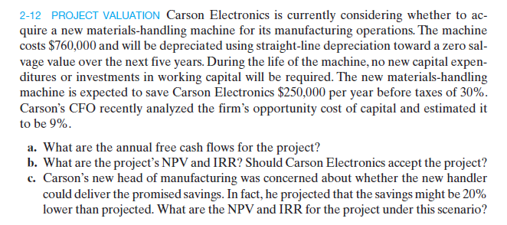
Question 5

Slide 27
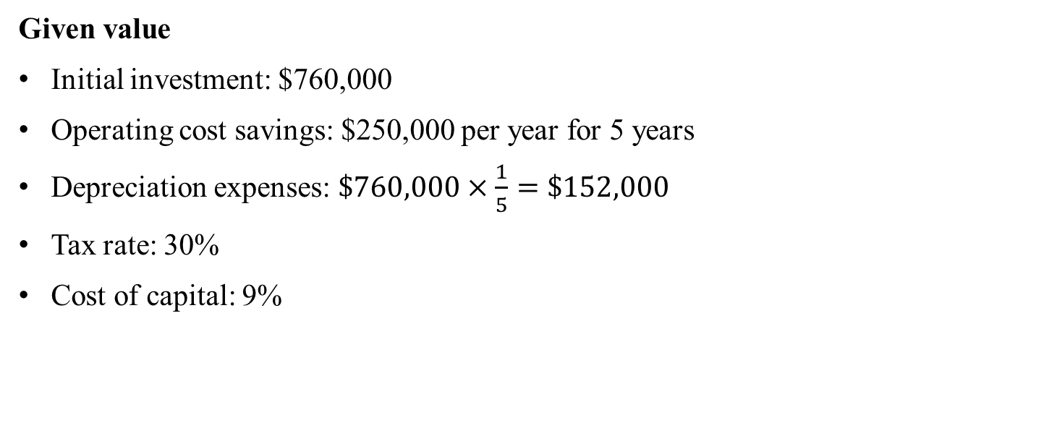
Question 5 (cont.)
Given value
Initial investment: $760,000
Operating cost savings: $250,000 per year for 5 years
Depreciation expenses: $\$760,000×\frac{1}{5}=\$152,000$
Tax rate: 30%
Cost of capital: 9%

Slide 28
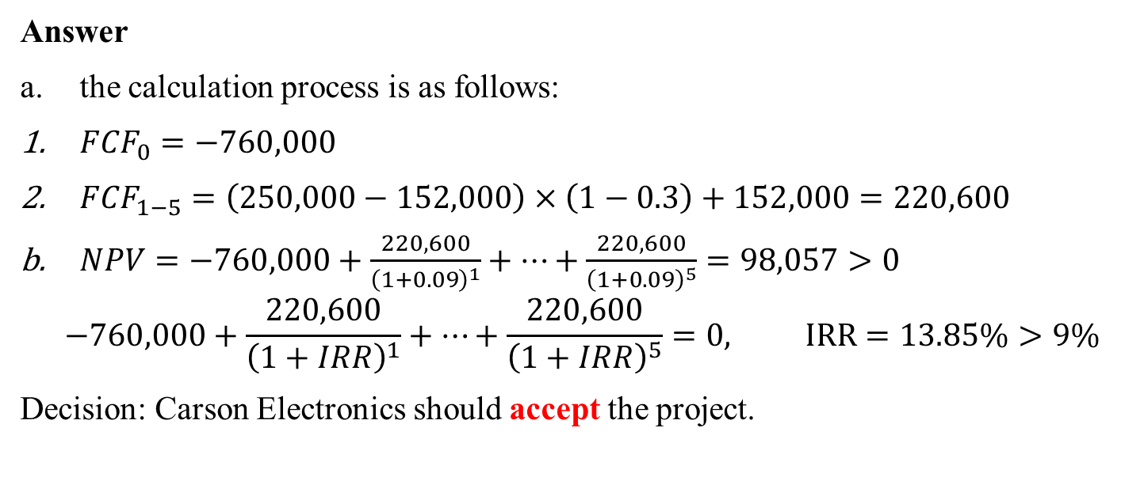
Question 5 (cont.)
Answer
the calculation process is as follows:
${FCF}_{0}=−760,000$
${FCF}_{1−5}=\left(250,000−152,000\right)×\left(1−0.3\right)+152,000=220,600$
$NPV=−760,000+\frac{220,600}{{\left(1+0.09\right)}^{1}}+…+\frac{220,600}{{\left(1+0.09\right)}^{5}}=98,057>0$
$$−760,000+\frac{220,600}{{\left(1+IRR\right)}^{1}}+…+\frac{220,600}{{\left(1+IRR\right)}^{5}}=0, IRR=13.85\%>9\%$$
Decision: Carson Electronics should accept the project.

Slide 29
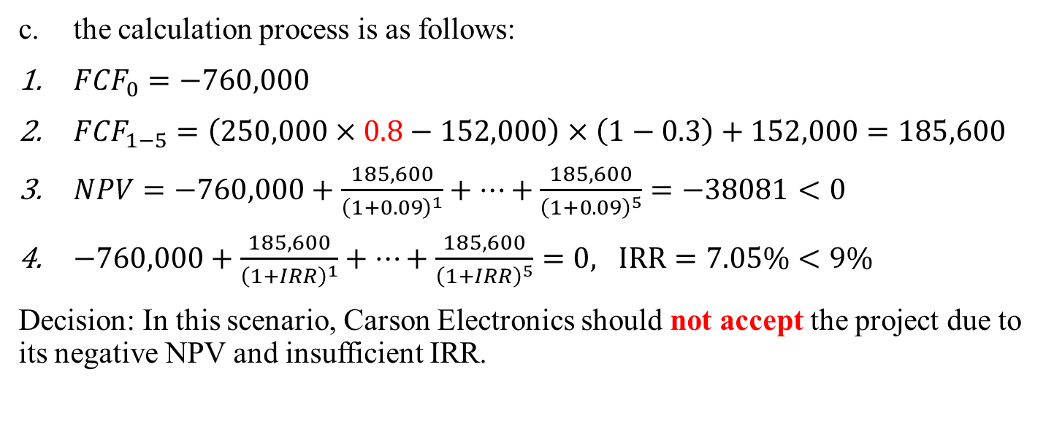
Question 5 (cont.)
the calculation process is as follows:
${FCF}_{0}=−760,000$
${FCF}_{1−5}=\left(250,000×0.8−152,000\right)×\left(1−0.3\right)+152,000=185,600$
$NPV=−760,000+\frac{185,600}{{\left(1+0.09\right)}^{1}}+…+\frac{185,600}{{\left(1+0.09\right)}^{5}}=−38081<0$
$−760,000+\frac{185,600}{{\left(1+IRR\right)}^{1}}+…+\frac{185,600}{{\left(1+IRR\right)}^{5}}=0, IRR=7.05\%<9\%$
Decision: In this scenario, Carson Electronics should not accept the project due to its negative NPV and insufficient IRR.

